Slide 1


Who learns what and from whom?
A study of organizational learning in a rapidly growing industry:
Solar installation in Austin, Texas
@markchand • mark.hand@utexas.edu
Mark Hand, Ariane Beck, Xue Gao and Varun Rai

Slide 2
Bottom line up front:
The murkiness around definitions of soft costs is problematic. We’re building an ontology to fix that.
Some of this ambiguity is about tacit versus codified knowledge and its local v. non-local sources, which we hope to clear up.
Understanding soft cost knowledge flows requires understanding the networks of learning and knowledge around them. We’re building that, too.
Notes:
I
What are soft costs?
Not that simple, see?
Definitions vary across literatures
And they are different in practice than in literature
So our first step toward understanding soft costs was agreeing on how to define them
Here’s what we came up with
Our hope is that others will use this ontology in their own work on soft costs, and help us adjust is where necessary
II
OK, so we have some definitions.
But that’s not enough—firms have to learn about these soft cost-reducing techniques. How do they do that? And do different patterns of learning correlate with firm success?
First project: Developing a conceptual map of types of learning
Literature discusses tacit v. codified knowledge and local v. Non-local sources for that knowledge
Next steps: Interview installers to find out where they place these elements in this space
Then, based on what the literature predicts people wills/should do with those types of knowledge
Then: Interview those installers again to determine how they go about learning.
Test two hypotheses: 1. Are firms that correctly match process to element characteristics more likely to succeed? 2. Assuming that knowledge becomes more codified and non-local as an industry grows, are firms that focus on dynamic capabilities more likely to succeed over time?
Questions: This doesn’t feel any farther along than ASES. Also, how to handle recall?
III
The patterns of learning exhibited in an industry make up what in management literature calls the knowledge network
In that literature, centrality in a knowledge network should mean more and better knowledge which, according to the knowledge-based view of the firm, should mean greater success
One open in that literature is the search-transfer problem: Do firms search for knowledge and acquire relationships as a result? Or do they mostly absorb and mine information from existing networks?
Initial results from qualitative interviews:
Next: Lots of interviews with lots of people—everyone in the Austin solar industry, in fact.

Slide 3
A little context
SEEDS2
Soft costs
The Energy Systems Transformation group
Notes:
https://energy.gov/eere/sunshot/solar-energy-evolution-and-diffusion-studies-2-state-energy-strategies-seeds2-ses
Box > SEEDS2 > Add SunShot / LBJ logos / Tower
SEEDS1, a multi-initiative funding program of which we were part of, was great.
See link on slide 4 about SEEDS2
Rai Group - Varun may have a presentation on the group’s whole work
Gaming, patents (supply side), SEEDS1 (decision-making, ABM). Knowledge flow, diffusion of innovation, behavior. All quantitative.

Slide 4
1.1/ What are soft costs? That depends on who you ask:
 | NREL | DOE | LBNL | RMI | SolSmart
Customer Acquisition | ✔ | ✔ | ✔ | ✔ | ✔
PII | ✔ | ✔ | ✔ | ✔ | ✔
Permit fee |  | ✔
Installation Labor | ✔ | ✔ | ✔ | ✔ | ✔
Finance | ✔ |  |  | ✔ | ✔
Sales Tax |  | ✔ | ✔
Transaction cost |  | ✔
Profit margin |  | ✔ |  | ✔
Indirect costs |  | ✔
Supply chain |  | ✔
Other | ✔ (profit, overhead) |  | System Design |  | Planning/ zoning
Notes:
Go through support doc in Ariane’s Sep 7 email
Consider highlighting the row where everyone agrees
Sample based on recent reports or website from each organization. All slightly different.
All of these were used as search terms in addition to soft cost and balance of systems.
NREL: soft costs road map
DOE: https://energy.gov/eere/articles/soft-costs-101-key-achieving-cheaper-solar-energy
LBNL: https://emp.lbl.gov/sites/all/files/german-us-pv-price-ppt.pdf
RMI: Figure 1 in REDUCING SOLAR PV SOFT COSTS: A FOCUS ON INSTALLATION LABOR, technically finance and profit margin are a separate category
SolSmart: http://www.gosparc.org/faqs/#Q-4
Conceptualize soft costs and relevant features/factors effecting cost in systematic and sharable format
Visualize relationships between concepts and processes imposing costs, source of cost (e.g., learning, implementation, resource access), and relevant actors
Identify impact of costs, actors, and learning mechanisms to strategically target policy

Slide 5
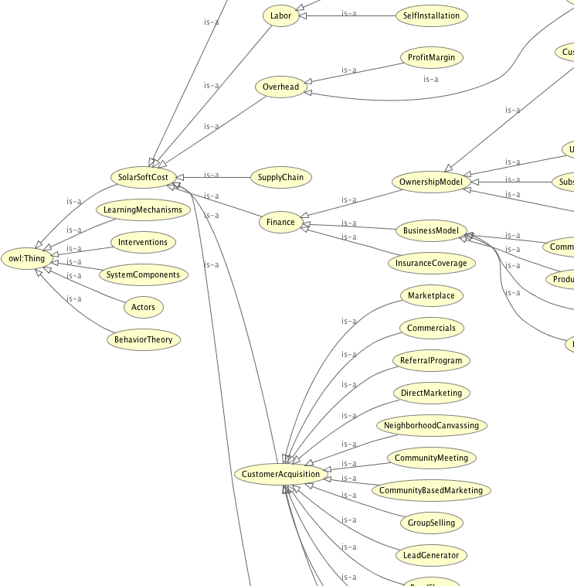
1.2 What’s an ontology?
Conceptualizes soft costs and relevant features/factors effecting cost in systematic and sharable format
Visualizes relationships between concepts and processes imposing costs, source of cost (e.g., learning, implementation, resource access), and relevant actors
Identifies impacts of costs, actors, and learning mechanisms to strategically target policy
Notes:
Conceptualize soft costs and relevant features/factors effecting cost in systematic and sharable format
Visualize relationships between concepts and processes imposing costs, source of cost (e.g., learning, implementation, resource access), and relevant actors
Identify impact of costs, actors, and learning mechanisms to strategically target policy
Top 3 levels of soft costs taxonomy shown here. Focus is on capturing relevant concepts and organizing them in such a way that they provide sufficient detail of the soft costs space while still being able to capture installer instances. We found that trying to subcategorize various customer acquisition strategies into sales and marketing, for instance, would make it difficult or impossible for smaller firms than have sales and marketing as a single category. Thus, it will be more useful to keep the strategies as the next level and including properties to capture sub-costs, such as advertising. This would allow installers to indicate which strategies they use, and then list advertising costs either globally as a customer acquisition cost or individually where it is attributable to specific strategy.
References
https://protege.stanford.edu/publications/ontology_development/ontology101.pdf
https://www.cambridgesemantics.com/blog/semantic-university/

Slide 6
1.3/ What’s an ontology good for?
For installers
An advanced knowledge management system
Tracking data for in-house analytics
For policymakers
Landscape view of knowledge flows within solar ecosystem
Identification of gaps that present a barrier to local industry
Targeted policy around which could reduce soft costs
For researchers
Comprehensive view of complex and variable knowledge system
Gap analysis of current research
Notes:
BENEFITS
Common schema to identify and relate knowledge in the solar domain
Large, diverse group of actors can collaborate by
Contributing the knowledge in their domain of expertise, specifying the relevant level/geography
Selecting the parts of the ontology relevant to their goals for use
Choosing to push information (e.g., data) back to the community
Reusability and standardization are key
Time stamps provide longitudinal understanding of how industry grows and changes
Realizing potential depends on an active, collaborative community
Extending concepts
Increasing comprehensive coverage
Contributing data
FOR INSTALLERS
As Knowledge Management System
Track firm data for in house use
Access data contributed by community
Management
Given certain resources, what is best use?
Given certain goals, what is best practice?
Benchmark against aggregated data
Knowledge base development too time intensive for small installers
155 publications and reports reviewed for concepts
~500 concepts considered for inclusion
Open source significantly lowers barrier to using advanced knowledge management practices
FOR POLICMAKERS
Landscape view of knowledge flows within solar ecosystem
Not just which policies exist where, but how they relate to soft costs, actors, research findings
Policy outcomes
Comprehensive view of network actors
Knowledge flows between them
Gaps in networks that present a barrier to local industry
Improve automated search, industry tracking, and documentation/identification of best practices
Understanding best practices and areas of greatest need for support
Strategically target policy to reduce solar soft costs
FOR RESEARCHERS
Comprehensive view of complex and variable knowledge system
As a research tool
Gap analysis of current research
Which knowledge areas of ontology are best populated?
Which geographical regions are well studied, which are absent?
What potential relationships, benefits, or outcomes are missing?
Which installer communities might fit a research design?
Leverage knowledge of large community
Contribute research results and findings to connect with policy makes and practitioners
-------
1. Variation in categories can make it more difficult to share data across studies
2. Search results…: re: diffusion studies, our perceptions paper did not come up, nor did ABM papers, or many of the references we use in PEB and TPB studies.
3. Initial ideas…: instinct on C&A subcategories is to resolve into sales and marketing, but when trying to map to how we would actually capture installer costs as instances this revealed that focusing on individual strategies would likely prove more useful.
Customer Acquisition
sales and marketing subcategories
Not consistent cost categories or tracking by installers
Not necessarily useful for capturing cost or identifying best practice
Strategies (e.g., referral program, lead generator, marketplace)
Installers can identify which strategies they use
Properties such as hasAdvertisingCost, hasTrainingCost, hasConversionRate can provide insights into best practices (more so when merged with TTS pricing data)
4. Supply chain n = 6, System design n = 4 on Science Direct (finance = 28, PII = 21, soft cost = 19, customer acqu. = 11)

Slide 7
2.1/ What gets learned, and how?
How do we categorize learning?
According to knowledge: tacit v. codified
What soft cost knowledge is tacit v. codified?
See Polanyi (1958), Howells (1996), Venkitachalam and Busch (2012)
According to source: local v. non-local
To what extent do installers rely on local v. non-local sources?
See Bathelt et al (2004), Asheim and Isaksen (2002), Storper and Venables (2004)
Notes:
II
OK, so we have some definitions.
But that’s not enough—firms have to learn about these soft cost-reducing techniques. How do they do that? And do different patterns of learning correlate with firm success?
First project: Developing a conceptual map of types of learning
Literature discusses tacit v. codified knowledge and local v. Non-local sources for that knowledge
Next steps: Interview installers to find out where they place these elements in this space
Then, based on what the literature predicts people wills/should do with those types of knowledge
Then: Interview those installers again to determine how they go about learning.
Test two hypotheses: 1. Are firms that correctly match process to element characteristics more likely to succeed? 2. Assuming that knowledge becomes more codified and non-local as an industry grows, are firms that focus on dynamic capabilities more likely to succeed over time?
Questions: This doesn’t feel any farther along than ASES. Also, how to handle recall?

Slide 8
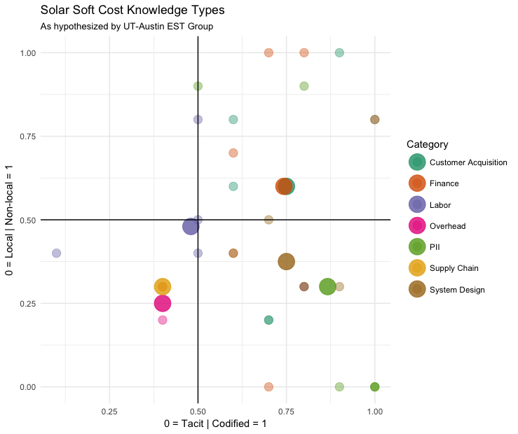
2.2/ What is tacit v. codified, local v. non-local?

Slide 9
2.2/ What learning patterns → success?
H1: Firms that correctly match knowledge source to knowledge characteristics are more likely to succeed
H2: Assuming that knowledge becomes more codified and non-local as an industry grows, firms that build dynamic capabilities are more likely to succeed over time

Slide 10
2.3/ Next steps
What will/should people do with those types of knowledge?
Installer interviews
Where do they place these elements in this space?
Installer interviews, Round II: How do those installers go about learning in practice?

Slide 11
3.1/ Knowledge networks in the solar industry Making decisions about learning in a nascent market
Who learns what (knowledge acquisition/elements),
from whom (knowledge production/learning),
and how (spillover mechanisms/pathways)?
Whole network of ~600 employees from Austin’s ~80 firms
Surveys and interviews (and survey interviews?)
Against installation (and revenue) data
See Phelps et al (2012), Own-Smith and Powell (2004), Broekel and Boschma (2012), Tsai (2001)
Notes:
The patterns of learning exhibited in an industry make up what in management literature calls the knowledge network
In that literature, centrality in a knowledge network should mean more and better knowledge which, according to the knowledge-based view of the firm, should mean greater success
One open in that literature is the search-transfer problem: Do firms search for knowledge and acquire relationships as a result? Or do they mostly absorb and mine information from existing networks?
Initial results from qualitative interviews:

Slide 12
3.2/ Early hypotheses
H1: Firms that make themselves network central (and network central in highly central clusters) will be more successful
H2: Firms that are identified as knowledge-sharing will be more successful
H3: Firms that shift their learning over time from tacit/local to codified/non-local will be more successful
H4: Firms that shift over time from building networks to exploiting them will be more successful

Slide 13
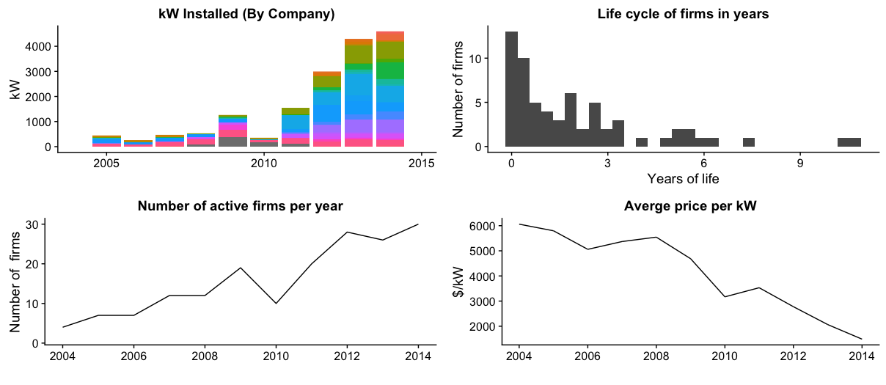
3.3/ Austin solar at a glance

Slide 14
3.4/ Instance-based learning surveys Survey questions, abbreviated
What is the [most recent/first] thing you remember learning about [customer acquisition]?
How did you learn it? [Person, resource, event…]
[If a person] What was their relationship to you?
Where was [that person/resource/event] based?
When was that?
Had you already [used that source/ met that person/been to that event] before then?

Slide 15
3.5/ Early results Responses from formative interviews
Vendors, manufacturers, and distributors key sources of information in the earliest days of the market
“Local” seems to mean “I-35”
Local relationships for non-competitive information; national relationships for more sensitive questions
Tight relationships among early players and local regulator (Austin Energy)
The importance of “learning by doing”

Slide 16
Bottom line, at the bottom
The murkiness around definitions of soft costs is problematic. Help us clear it up?
Some of this ambiguity is about the relationship tacit versus codified knowledge and local v. non-local sources, which we hope to clear up.
Understanding soft costs requires understanding the networks of learning and knowledge around them, which we’re building.
Notes:
I
What are soft costs?
Not that simple, see?
Definitions vary across literatures
And they are different in practice than in literature
So our first step toward understanding soft costs was agreeing on how to define them
Here’s what we came up with
Our hope is that others will use this ontology in their own work on soft costs, and help us adjust is where necessary
II
OK, so we have some definitions.
But that’s not enough—firms have to learn about these soft cost-reducing techniques. How do they do that? And do different patterns of learning correlate with firm success?
First project: Developing a conceptual map of types of learning
Literature discusses tacit v. codified knowledge and local v. Non-local sources for that knowledge
Next steps: Interview installers to find out where they place these elements in this space
Then, based on what the literature predicts people wills/should do with those types of knowledge
Then: Interview those installers again to determine how they go about learning.
Test two hypotheses: 1. Are firms that correctly match process to element characteristics more likely to succeed? 2. Assuming that knowledge becomes more codified and non-local as an industry grows, are firms that focus on dynamic capabilities more likely to succeed over time?
Questions: This doesn’t feel any farther along than ASES. Also, how to handle recall?
III
The patterns of learning exhibited in an industry make up what in management literature calls the knowledge network
In that literature, centrality in a knowledge network should mean more and better knowledge which, according to the knowledge-based view of the firm, should mean greater success
One open in that literature is the search-transfer problem: Do firms search for knowledge and acquire relationships as a result? Or do they mostly absorb and mine information from existing networks?
Initial results from qualitative interviews:
Next: Lots of interviews with lots of people—everyone in the Austin solar industry, in fact.

Slide 17
Thanks! Questions? Suggestions?
Who learns what and from whom?
A study of organizational learning in a rapidly growing industry:
Solar installation in Austin, Texas
@markchand • mark.hand@utexas.edu
Varun Rai, Xue Gao, Ariane Beck and Mark Hand

Slide 18
Backup slides
👇

Slide 19
1.3/ Insights from building an ontology
Variation in high level categories of soft costs
Search results do not always produce expected results
Diffusion studies on customer behavior not well represented
Initial ideas will not necessarily track to best ways to capture costs, e.g.,
Supply Chain and System Design produce fewer results
Notes:
1. Variation in categories can make it more difficult to share data across studies
2. Search results…: re: diffusion studies, our perceptions paper did not come up, nor did ABM papers, or many of the references we use in PEB and TPB studies.
3. Initial ideas…: instinct on C&A subcategories is to resolve into sales and marketing, but when trying to map to how we would actually capture installer costs as instances this revealed that focusing on individual strategies would likely prove more useful.
Customer Acquisition
sales and marketing subcategories
Not consistent cost categories or tracking by installers
Not necessarily useful for capturing cost or identifying best practice
Strategies (e.g., referral program, lead generator, marketplace)
Installers can identify which strategies they use
Properties such as hasAdvertisingCost, hasTrainingCost, hasConversionRate can provide insights into best practices (more so when merged with TTS pricing data)
4. Supply chain n = 6, System design n = 4 on Science Direct (finance = 28, PII = 21, soft cost = 19, customer acqu. = 11)

Slide 20
1.4/ The utility of an ontology
Use of corpus
Emphasizes areas of current focus, which provides opportunity for gap analysis
Developing Survey
Ontology provides systematically developed lists of responses (e.g., soft cost categories, external learning mechanisms)
Conducting interviews
Soft costs taxonomy provides visual aid to focus interviewee on high level cost categories

Slide 21
1.5/ Ontology properties
Subject Object | SoftCosts | Actors | Learning Mechanisms | Interventions | Components
Actors | learnedFrom |  | hasSource | deployedBy sponsoredBy | installedBy usedBy purchasedBy suppliedBy manufacturedBy distributedBy
Learning Mechanisms | learnedBy hasLearningCost | provides learnsBy |  | deliveredBy | learnedBy
Interventions | reducedBy hasInterventionCost | deployIntervention sponsorIntervention | usedBy |  | diffuseBy
Decision Making | - | - | - | useConstruct useTheory useFramework | -
Components | hasComponentCost | installComponents useComponents purchaseComponents supplyComponents mfgComponents distributeComponents | applyTo |  | hasInstallationTime hasInstallationCost hasDesignTime hasDesignCost hasSupplyCost hasConversionRate
Notes:
The preliminary set of superclasses, in the first row of the Table have been identified thus far as necessary to meet to the scope of the ontology in the Requirement Specification. The relationships between concepts are represented as triples with a subject, predicate, and object. The triple <a P b> indicates that b is a value or property P for subject a. For example, SoftCosts learnedFrom Actors, which when specified using subclasses might read CustomerAcquisition (SoftCosts) learnedFrom TradeOrganization (Actors). Table 1 provides a number of preliminary relationships identified between classes. These have not been finalized, but are intended to be illustrative of how the ontology captures complex relationships.

Slide 22
Knowledge Spillovers and Cost Reductions in Solar Soft Costs Varun Rai (PI) / The University of Texas at Austin Greg Nemet (Co-PI) / University of Wisconsin – Madison
1496-1541
Project Summary
KEY PERSONNEL
This project will systematically study the size and mechanisms of knowledge spillovers in the solar industry, both utility-scale and rooftop solar photovoltaic (PV). Specifically, we will focus on how learning-by-doing (LBD) spillovers contribute to solar soft costs reductions in the U.S. PV installation industry. LBD elements related to solar soft costs include such things as installation processes, permitting processes, customer acquisition, and overhead costs. We will determine how important spillovers are, what types of knowledge are most likely to spill over, how networks of actors affect spillovers, and how policies can be designed to address them. We will address these questions using a comprehensive, multi-method, and data-driven approach, including archival research, expert interviews, case studies, surveys, patent analysis, and network analysis.
PI: Dr. Varun Rai (The University of Texas at Austin)
Co-PI: Dr. Greg Nemet (University of Wisconsin – Madison)
Senior Personnel:
Dr. Douglas Hannah (The University of Texas at Austin), Dr. Adam Douglas Henry (University of Arizona), Dr. William Rand (University of Maryland), Erik Funkhouser (Research into Action)
PROJECT PLAN
Federal funds: $ 1,250,000 Cost-share: $ 0 Total: $ 1,250,000
Key Milestones & Deliverables
Year 1 | Conduct archival research, interview firms for case studies, develop and test survey instrument, prepare data and models for pricing analysis.
Year 2 | Complete case studies and cross-analysis, collect and analyze survey data, complete pricing analysis, create datasets for patent analysis and network modeling.
Year 3 | Complete patent analysis, network modeling, and overall synthesis of findings.
Impact
Project results will comprehensively address the knowledge system around soft costs, an important and complex problem area that lies at the heart of future reductions in PV installed costs.
A grounded, multi-method approach to understanding knowledge spillovers with an emphasis on how learning–by-doing spillovers contribute to solar cost reductions

Slide 23
Research Approach
Taxonomy, variables, and operationalization
Quantifying spillovers: “What is?”
Empirically establish the importance of spillovers
Identify differential impact of spillovers in utility vs. rooftop PV
Quantifying knowledge gaps: “What could be?”
Comprehensive picture of soft-costs knowledge system
Analytical Platform
Data and Analysis
Policy and Market Insights
Strategies for removing bottlenecks in critical knowledge flows
Data
Empirically establish the importance of spillovers
Identify differential impact of spillovers in utility vs. rooftop PV
Comprehensive picture of soft-costs knowledge system
Strategies for removing bottlenecks in critical knowledge flows

Slide 24
Multi-method, data-driven approach, including archival research, expert interviews, case studies, surveys, patent analysis, and network analysis – all focused on the singular issue of learning-by-doing (LBD) spillover.
Taxonomy of Soft-Costs Knowledge System
Processes of Knowledge Production and Acquisition
Actors and Their Network
Spillover Measurement
Spillover Mechanisms
Research Questions
Archival Research
Interviews & Cases
Survey
Pricing Analysis
Patent Analysis
Network Analysis
Research Tasks

